Slide 1
CAP770

Slide 2
B-Tree
B-Tree is a self-balanced search tree in which every node contains multiple keys and has more than two children.
A B-Tree is a special kind of tree in a data structure which is also called m-way tree

Slide 3
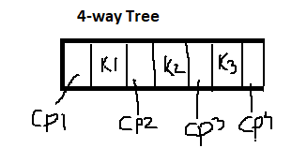
M-way tree
A multiway tree is a tree that can have more than two children. A multiway tree of order m (or an m-way tree) is one in which a tree can have m children.
Each node can have m-children
And m-1 children
Structure in node representation:

Slide 4
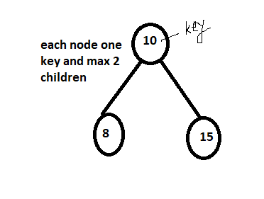
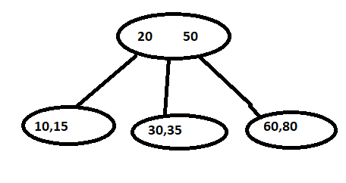
BST
M-way search tree
Key1<key2<key3
Key:2
Max children=3 so this is called
3- way search tree

Slide 5
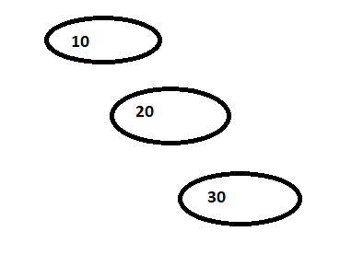
Suppose we want to create 10-way tree
And we have key: 10,20,30
To overcome this problem go for B-Tree

Slide 6
B-tree is a M-way tree with some rule.
Every node should have M/2 children
Root can have minimum 2 children
All leaf at same level
All the key values in a node must be in Ascending Order.

Slide 7
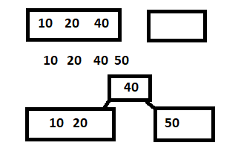
M=4-way tree
Keys: 10,20,40,50

Slide 8
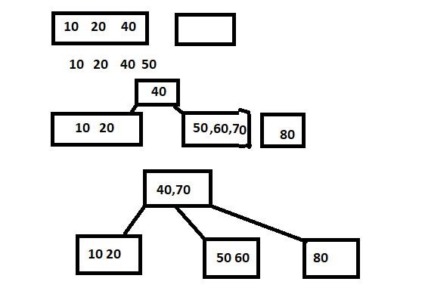
M=4-way tree
Keys: 10,20,40,50,60,70,80

Slide 9
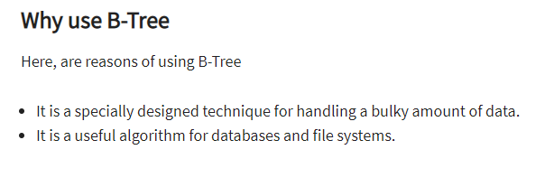

Slide 10
red-black tree
A red-black tree is a binary search tree with one extra attribute for each node: the colour, which is either red or black.
A red-black tree satisfies the following properties:
Red/Black Property: Every node is colored, either red or black.
Root Property: The root is black.
Leaf Property: Every leaf (NIL) is black.
Red Property: If a red node has children then, the children are always black.

Slide 11
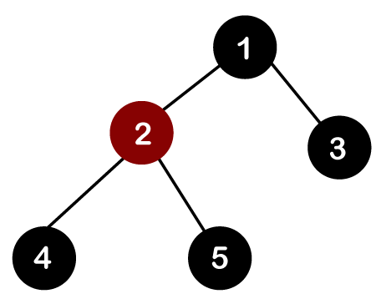

Slide 12
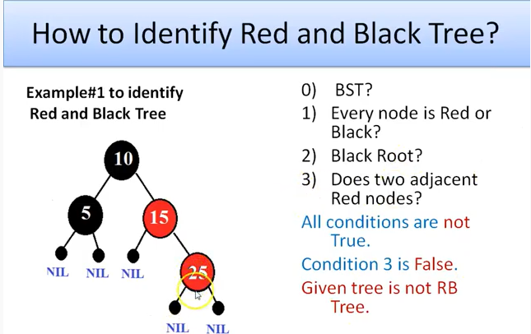

Slide 13
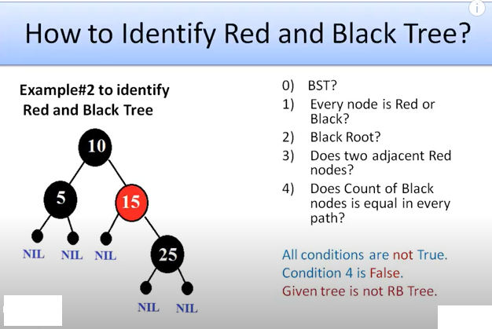

Slide 14
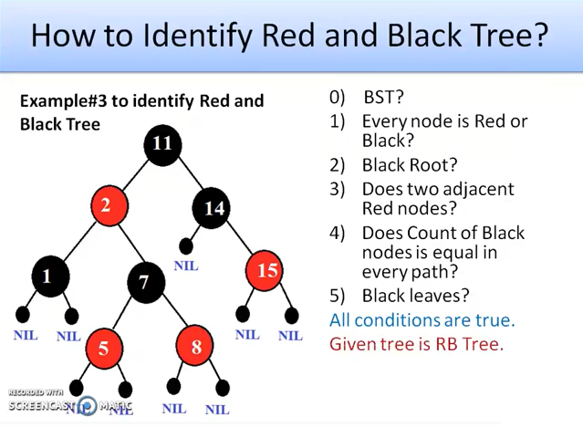

Slide 15
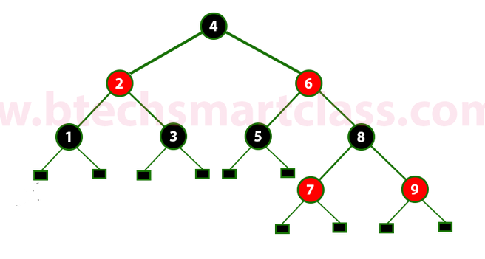

Slide 16
splay trees: properties and operations
A splay tree is a self-balancing tree
A splay tree contains the same operations as a Binary search tree, i.e., Insertion, deletion and searching, but it also contains one more operation, i.e., splaying. So. all the operations in the splay tree are followed by splaying.
Here splaying means that the operation that we are performing on any element should become the root node after performing some rearrangements. The rearrangement of the tree will be done through the rotations.

Slide 17
Rotations in Splay Tree
1. Zig Rotation
2. Zag Rotation
3. Zig - Zig Rotation
4. Zag - Zag Rotation
5. Zig - Zag Rotation
6. Zag - Zig Rotation
(zig-mean right, zag-means left)

Slide 18
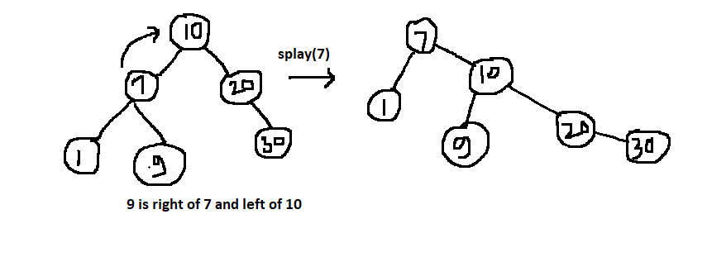
Zig Rotation
The Zig Rotation in splay tree is similar to the single right rotation in AVL Tree rotations. In zig rotation, every node moves one position to the right from its current position.

Slide 19
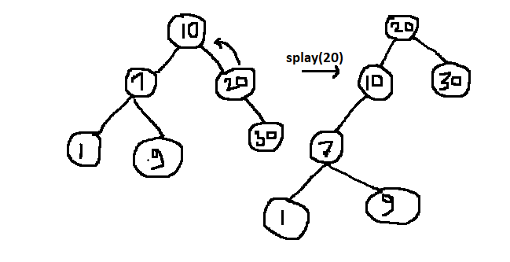
Zag Rotation
The Zag Rotation in splay tree is similar to the single left rotation in AVL Tree rotations. In zag rotation, every node moves one position to the left from its current position.

Slide 20
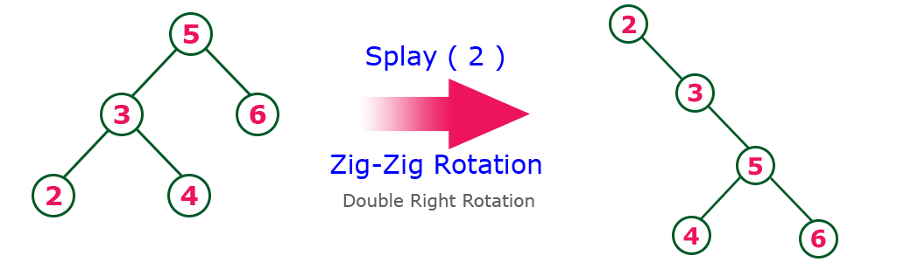
Zig-Zig Rotation
The Zig-Zig Rotation in splay tree is a double zig rotation. In zig-zig rotation, every node moves two positions to the right from its current position.
Element should have parent and grand parent to perform Zig-Zig rotation

Slide 21
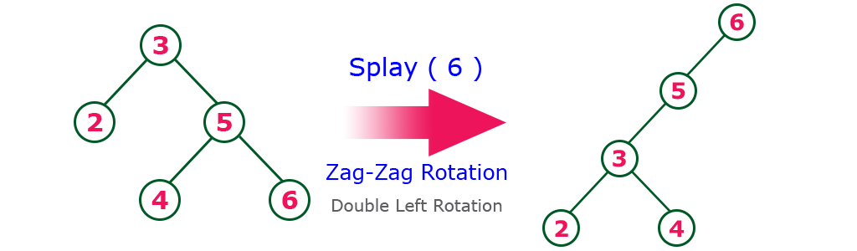
Zag-Zag Rotation
The Zag-Zag Rotation in splay tree is a double zag rotation. In zag-zag rotation, every node moves two positions to the left from its

Slide 22
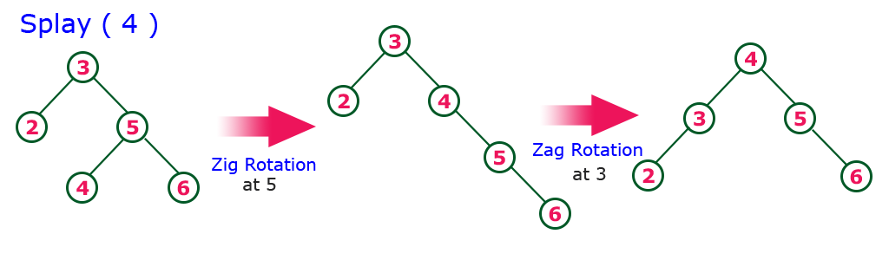
Zig-Zag Rotation
The Zig-Zag Rotation in splay tree is a sequence of zig rotation followed by zag rotation. In zig-zag rotation, every node moves one position to the right followed by one position to the left from its current position.

Slide 23
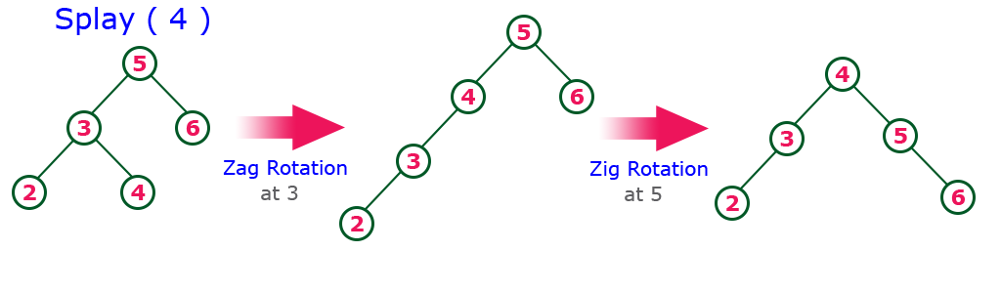
Zag-Zig Rotation
The Zag-Zig Rotation in splay tree is a sequence of zag rotation followed by zig rotation. In zag-zig rotation, every node moves one position to the left followed by one position to the right from its current position.

Slide 24
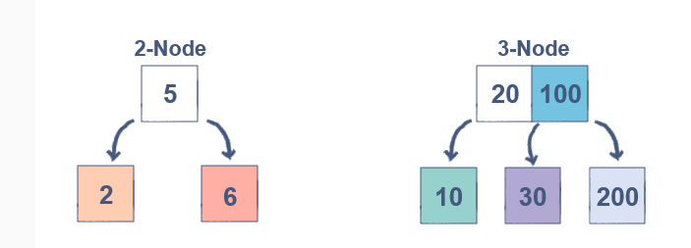
2-3 Tree
A 2-3 Tree is a Binary Search Tree where every node can be of two types:
2-Node: A node with a single data element that has two child nodes
3-Node: A node with two data elements that has three child nodes

Slide 25
Properties:
It is balanced in nature
Every Internal node is 2-Node or 3-Node
All leaf nodes are in same level
Data is store in sorted manner

Slide 26
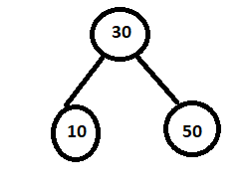

Example:
Consider Elements: 50, 30, 10, 70, 60
Step1:
Step2:
Step3:
50
30 50

Slide 27
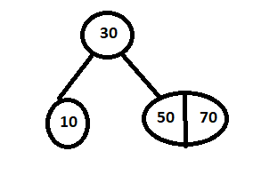
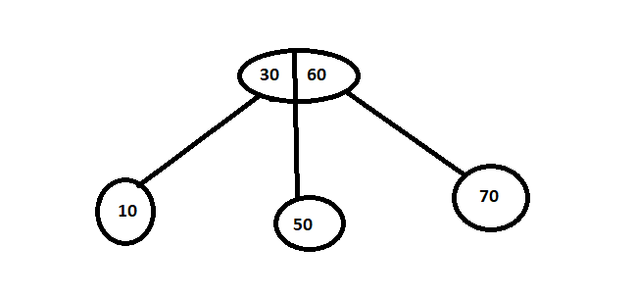
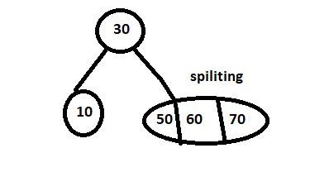
Step4:
Step5:

Slide 28


